Slide 1

Web APPLICATION Development (111834)
Dr. Owais Hussain

Slide 2

Agenda
Why not use Django Server?
Production Settings
Deployment on AWS Lightsail
NGINX and Gunicorn
Run on Startup
Deploying for Enterprise

Slide 3
Sample 2
Why not use Django Server?
Django comes with built-in server, which launches the web app with “manage.py runserver” command. However, it comes with some pitfalls:
It cannot handle more than a few concurrent requests.
The security is not strong enough for production purposes.
It lacks ability to monitor the performance in detail.
Although the default server launches quickly and is convenient. It must never be used except for Development and basic testing.
Django apps (or any other web app) should be deployed on web servers like Apache, NGINX, IIS, or Tomcat

Slide 4
Sample 2
Deployment on AWS Lightsail
A typical web app is deployed on a Linux distribution like Ubuntu, CentOS, or SUSE Linux. We will use Amazon AWS’s Lightsail service as an example of cloud server deployment.
You can alternatively create a virtual machine on Windows Hypervisor, VirtualBox, or any other tool for a local deployment as well.
Log into AWS account and go to Lightsail.
Create a new instance and pick Ubuntu Linux (OS only) as instance image.
Choose an instance payment plan, preferably the one with a free trial.

Slide 5
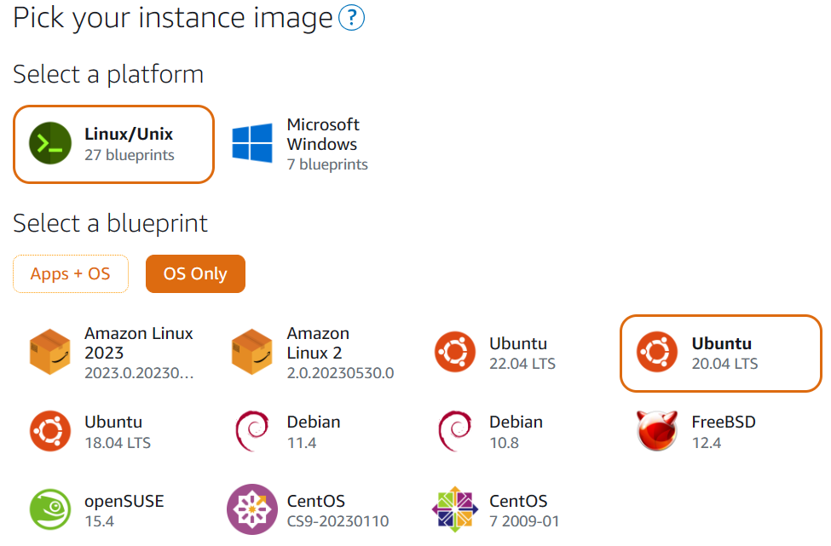
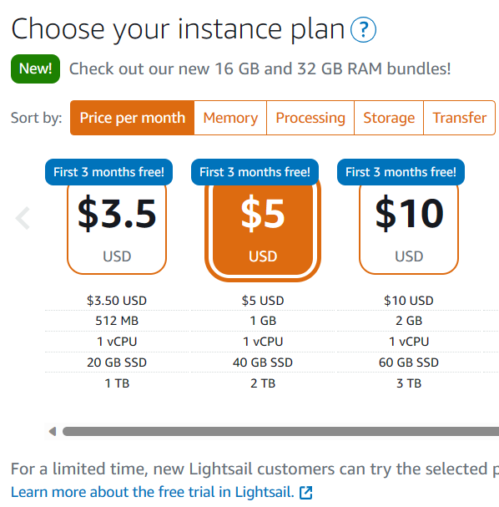
Sample 2
Deployment on AWS Lightsail

Slide 6
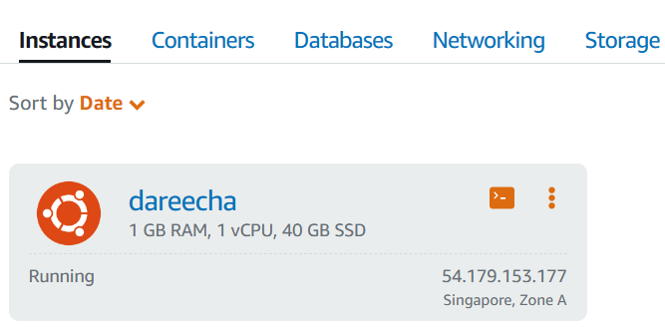
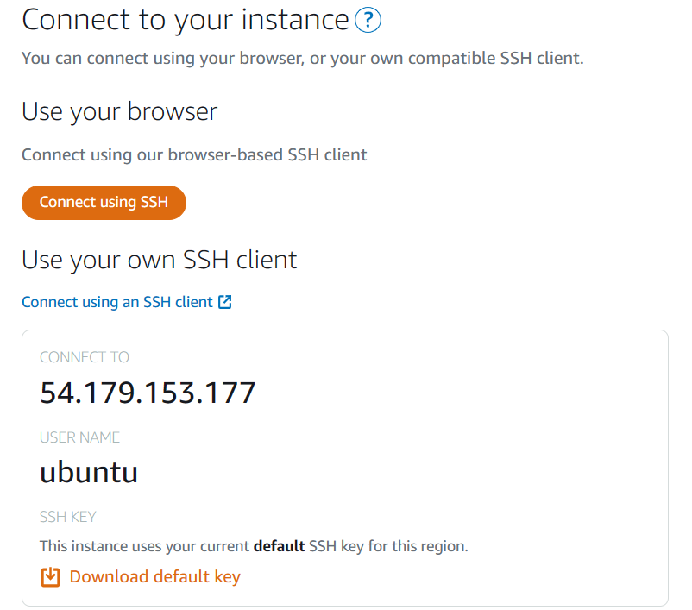
Sample 2
Deployment on AWS Lightsail
Name your instance “dareecha” and press “Create Instance”.
You should see a new lightsail instance in your dashboard.
Click on this instance to connect with its CLI.
The recommended way to connect with this instance is through SSH client. But for quick setup, we will use the web version.

Slide 7
Sample 2
Deployment on AWS Lightsail
Click “Connect using SSH” button.
Note that AWS has assigned a public IP to you. This is where you will be able to access the app.
As the Command Terminal windows appears, the first thing to do is to update & upgrade the OS:
sudo apt update sudo apt upgrade
Clone the baham-web repository’s production branch to /home/ubuntu:
git clone –b production https://github.com/esquaredsystems/baham-web.git

Slide 8
Sample 2
Deployment on AWS Lightsail
Install the pre-requisites:
sudo apt install nginx gunicorn
sudo apt install python3 python3-pip build-essential python3-dev
sudo reboot
Copy the cloned project to /opt/ as it’s a recommended practice
sudo cp –R /home/ubuntu/baham-web /opt/
cd /opt/baham-web/

Slide 9
Sample 2
Deployment on AWS Lightsail
In production environment, ALWAYS create a virtual environment. This can be done in /home/ubuntu as it does not have to require root.
cd /home/ubuntu/
python3 -m venv venv
source venv/bin/activate
Install the project dependencies:
pip3 install -r requirements.txt
Sometimes, one or more packages fail to install. Try to troubleshoot or install the dependencies one by one:
pip3 install django Pillow

Slide 10
Sample 2
Deployment on AWS Lightsail
The default SQLiteDB is suitable only for development and testing, for production, we will be using MySQL Server
sudo apt install mysql-server libmysqlclient-dev python3-mysqldb
Configure MySQL instance, set the root user password and create empty DB:
sudo mysql mysql>ALTER USER 'root'@'localhost' IDENTIFIED WITH mysql_native_password BY ‘MyPassword’;
create database baham;
We will now make all changes required to be made for the production settings.
Run the following to check if the settings are ready for production:
python3 manage.py check --deploy --settings=dareecha.settings

Slide 11
Sample 2
Production Settings
Some of the warnings you’ll see can be fixed quite simply:
Open the settings.py file via nano editor:
sudo nano dareecha/settings.py
Make all the required changes in this file, including those to fix the warnings.

Slide 12
Sample 2
Production Settings
Set DEBUG=False
Set ALLOWED_HOSTS to ‘*’ (or provide IP address range)
SECRET_KEY must be regenerated. The same key which is on your Github account or developers’ computer must never be used. Tip! Use https://randomkeygen.com
The default database in DATABASES should be configured to the production DBMS.
TIME_ZONE must match with the Server’s time zone.
STATIC_URL and other path settings should be according to the server’s file system.
Set CSRF_COOKIE_SECURE = True
Set SESSION_COOKIE_SECURE = True
Set SECURE_SSL_REDIRECT = True

Slide 13
Sample 2
Production Settings
Change the default Database settings to MySQL Server connection:
DATABASES = {
'default': {
'ENGINE': 'django.db.backends.mysql',
'NAME': 'baham’,
'USER': 'root’,
'PASSWORD': 'MyPassword',
'HOST': 'localhost’,
'PORT': '3306',
}
}

Slide 14
Sample 2
Production Settings
Save the file (Ctrl + O) and exit.
It is important to make a copy of this file so that in future builds it does not get overridden.
sudo cp dareecha/settings.py /home/ubuntu/
Now run migrations to create schema for the MySQL sever DB
python3 manage.py migrate
Since we moved to MySQL server, there might be some bugs during migrations. You can migrate to specific version or remove migrations files and run makemigrations again to make it work.
Create superuser: python3 manage.py createsuperuser

Slide 15
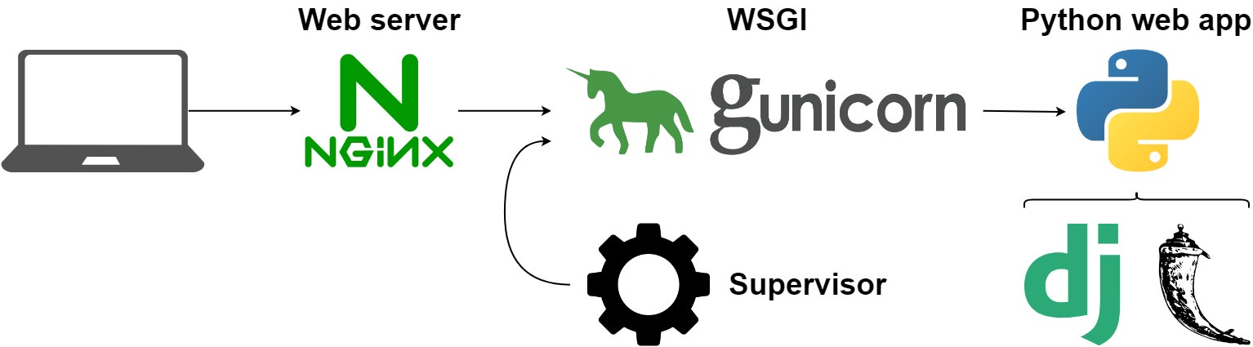
Sample 2
NGINX and Gunicorn
You are now ready to run on NGINX Server with Gunicorn.
NGINX is a Proxy Server, which serves like a waiter in a restaurant.
Gunicorn is a python WSGI server, just like runserver. It processes the HTTP requests and returns response, like the Chef in a restaurant. This way, the HTTP client has no information of what’s running behind the scenes.

Slide 16
Sample 2
Run on Startup
Finally, run the server with Gunicorn from /opt/baham-web:
gunicorn --bind 0.0.0.0:8000 dareecha.wsgi
In the browser, you should now be able to see the app on your designated IP address. However, this command will only run until your SSH session is alive. If the connection breaks, or the server reboots, the web app will no longer be active.
To make your deployment persistent, you’ll need to modify Gunicorn’s socket configuration. Create a new file with nano to edit:
sudo nano /etc/systemd/system/gunicorn.socket

Slide 17
Sample 2
Run on Startup
[Unit]
Description=gunicorn socket
[Socket]
ListenStream=/run/gunicorn.sock
[Install]
WantedBy=sockets.target

Slide 18
Sample 2
Run on Startup
Also create a gunicorn server file which will point to your deployment files:
sudo nano /etc/systemd/system/gunicorn.service
The configurations on next page should have exact paths for your virtual environment and baham-web directory.

Slide 19
Sample 2
Run on Startup
[Unit]
Description=gunicorn daemon
Requires=gunicorn.socket
After=network.target
[Service]
User=ubuntu
Group=www-data
WorkingDirectory=/opt/baham-web
ExecStart=/home/ubuntu/venv/bin/gunicorn --access-logfile --workers 3 --bind unix:/run/gunicorn.sock dareecha.wsgi:application
[Install]
WantedBy=multi-user.target

Slide 20
Sample 2
Run on Startup
Start and enable the Gunicorn socket to run on startup
sudo systemctl start gunicorn.socket
sudo systemctl enable gunicorn.socket
Next, enable NGINX reverse proxy for baham-web app.
sudo nano /etc/nginx/sites-available/baham-web
This file will provide server settings specific to baham-web. Paste the contents on next page to this file and save.

Slide 21
Sample 2
Run on Startup
server {
listen 80;
server_name 127.0.0.1;
location = /favicon.ico { access_log off; log_not_found off; }
location /static/ {
root /opt/baham-web;
}
location / {
include proxy_params;
proxy_pass http://unix:/run/gunicorn.sock;
}
}

Slide 22
Sample 2
Run on Startup
Activate the newly created configuration and restart NGINX to apply changes.
sudo ln -s /etc/nginx/sites-available/baham-web /etc/nginx/sites-enabled/
sudo systemctl restart nginx
In a nutshell, we created socket and service configurations for the baham-web and told NGINX that this is a new web app which must be enabled on service startup.

Slide 23
Sample 2
Deploying for Enterprise
Using cookiecutter (python package) is a good way to setup the app for production: cookiecutter https://github.com/pydanny/cookiecutter-djangopackage.git
This will create a new project which will be highly suitable to be deployed in production. You will notice new files which did not come when you created the Django project, for example:
.travis.yml is build configuration file for Travis, a Continuous Integration utility
AUTHORS, CONTRIBUTING, HISTORY, LICENSE, README are reStructured text format files to provide various project-related descriptions.
requirements_xyz.txt files list all dependencies which can be installed via a single command.
setup.py file is used to publish the app; tasks.py provides functions to clean, lint, rebuild, test, generate docs and release the app; tox.ini is a config file for a test command line tool that is used to automate testing in Python.
Follow the official documentation: https://cookiecutter.readthedocs.io/en/stable
Notes:
For this tutorial, we will use a simpler approach

Slide 24



THANK YOU
Owais Hussain
+92 345-3174270
owais.hussain@kiet.edu.pk
https://www.researchgate.net/profile/Owais-Hussain-3

